Slide 1
CS 471/571 Software Engineering: Overview
Dianxiang Xu
Department of Computer Science
Boise State University

Slide 2
Instructor
Dr. Dianxiang Xu
  Office: MEC 302A
  Email: dianxiangxu@boisestate.edu
  Phone: 208-426-5734
  Website: http://cs.boisestate.edu/~dxu/
Office Hours
  WF 2-5pm or by appointment

Slide 3
Survey Questions
What programming languages are your familiar with?
What is the most complex program you have ever written?
  Lines of code (LOC)
How did you write your program?
Are you familiar with UML?

Slide 4
Survey Questions - cont
How do you find bugs in software?
  Jeff’s Cruise Control simulation http://www.doc.ic.ac.uk/~jnm/book/index.html
How many bugs in Windows?
  Suppose defect rate: 1/10,000 LOC
  XP: 40M;Vista (07): 50M, Windows 7 (09): 40M
  Mac OS X “Tiger” v10.4: 85M
  Facebook (including backend code): 60M
  http://www.informationisbeautiful.net/visualizations/million-lines-of-code/

Slide 5
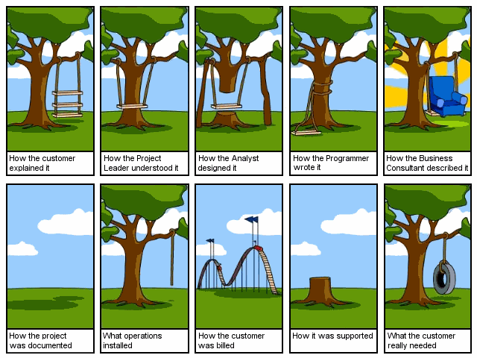
Software Development Nightmare http://www.kunxi.org/files/2006/08/o_software-project.jpg
Notes:
Group discussion: (1) What are the software development problems? (2) What is your favorite part? why?

Slide 6
Joke?
“If the automobile industry had developed like the software industry, we would all be driving $25 cars that get 1,000 miles to the gallon.”
“Yeah, and if the cars were like software, they would crash twice a day for no reason, and when you called for service, they’d tell you to reinstall the engine.”

Slide 7
How Cars Are Manufactured?
User requirement - engine power, all-wheel, seating, comfort, MP3 player
Detailed design - blueprints, design documents
Verify design - simulation, prototyping
Develop parts/components - test each component, components may be reused
Assemble the car - test the car (front/side crash tests, stability tests)
Usability testing (feedback from drivers/ passengers)

Slide 8
Objectives
Explain how software life-cycles address the needs for a rigorous approach to software development
Apply methods (e.g., Use Cases, Stories, UML) for documenting the requirements and design of a software system
Understand procedure-oriented and object-oriented software design methods

Slide 9
Objectives – cont’d
Contribute effectively to a software development team during the early phases of a project
Identify appropriate verification and validation activities for a software project
Understand other contemporary topics

Slide 10
Prerequisite
CS230 and either CS 321 or CS342
Object-Oriented Programming

Slide 11
Grading
Team Project: 30 points
Individual Assignments: 25 points
Quizzes: 5 points
Midterm: 15 points
Final: 25 points
Final grades: A for 90% or above, B for 80 to 89%, C for 70 to 79%, D for 60 to 69%, and F for less than 60%.

Slide 12
Assignments
All assignments will be announced in class and posted on blackboard.
If you miss class for any reason, it is your responsibility to find out what assignments you missed.
No late assignments will be accepted and there are no make-up exams.
Discuss unusual circumstances in advance with the instructor.

Slide 13
Team Project
Typically 4 members
  Exceptions possible (3 or 5 members)
Details will be discussed later

Slide 14
Academic Honesty
All assignments must be completed in a manner consistent with BSU code of academic conduct (e.g., described in the BSU Student Handbook).
Cheating on an exam or plagiarizing others’ work will result in a grade of zero, and possibly further disciplinary action.

Slide 15
Topics
What is software engineering?
Software development process and life cycle
Agile software development
Cohesion and coupling
Requirements analysis
Object-oriented design
Verification and validation

Slide 16
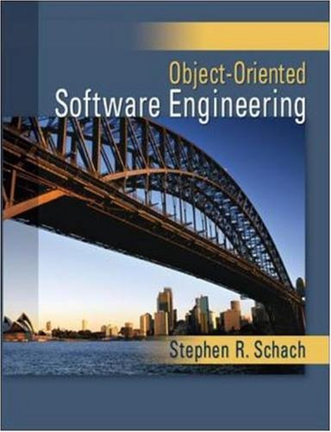
Textbook
McGraw Hill. 2008. ISBN 978-0-07-352333-0

Slide 17
Supplementary Materials
Simms, Chris and Johnson, Hillary Louise. The Elements of Scrum. 2011.
Shari Lawrence Pfleeger and Joanne M. Atlee, Software Engineering: Theory and Practice, 4th Edition. Prentice-Hall, 2009.
Steve McConnell. Code Complete: A Practical Handbook of Software Construction. 2nd Edition. Microsoft Press, 2004.
Martin Fowler, Kent Beck, John Brant, William Opdyke, and Don Roberts. Refactoring: Improving the Design of Existing Code. Addison-Wesley, 1999.

Slide 18
Tentative Schedule (Subject to Change)
Week | Dates | Topics / Chapters
1 | 8/25-8/29 | Ch 1 What Is Software Engineering
2 | 9/01-9/05 | Introduction to Team Project, Ch 2 Life Cycle Models
3 | 9/08-9/12 | Ch 2 Agile Development
4 | 9/15-9/19 | Ch 2 Life Cycle Models
5 | 9/22-9/26 | Ch 3 Unified Process, Ch 4 Teams
6 | 9/29-10/03 | Ch 7 From Modules to Objects
7 | 10/06-10/10 | Ch 7 From Modules to Objects, Ch 6 Testing
8 | 10/13-10/17 | Ch 6 Testing
9 | 10/20-10/24 | Midterm Project Presentations and Midterm Exam
10 | 10/27-10/31 | Ch 10 Requirements
11 | 11/03-11/07 | Ch 11 Analysis
12 | 11/10-11/14 | Ch 12 Design, Ch 9 Planning
13 | 11/17-11/21 | Ch 12 Design
14 | 11/24-11/28 | Thanksgiving
15 | 12/01-12/05 | Ch 13 Implementation, Ch 8 Reuse and Portability
16 | 12/08-12/12 | Project Presentations, Final Review

Slide 19
Special Needs
Students with disabilities needing accommodations to fully participate in this class should contact the Disability Resource Center (DRC). All accommodations MUST be approved through the DRC. Please stop by Administration 114 or call 208-426-1583 to make an appointment with a disability specialist. To learn more about the accommodation process, visit our website at http://drc.boisestate.edu.

